Slide 1


ZAR League of Hotels #WordPress
Arehman Jamal
Iyer Rahul Rajan
Zubin Kadva

Slide 2
WordPress ???
Blogging System
CMS
Plugins
Widgets
Themes

Slide 3
Platform???
PHP
MySQL
GPLv2
Successor to b2/cafelog

Slide 4
Roadmap
Version | Date
4.1 | December 10, 2014
4.0 | September 3, 2014
3.9 | April 16, 2014

Slide 5
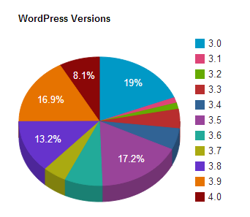
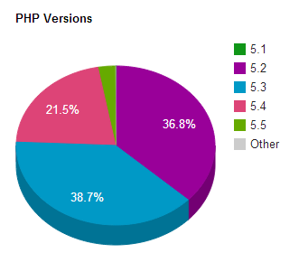
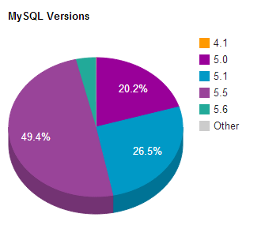
Statistics

Slide 6
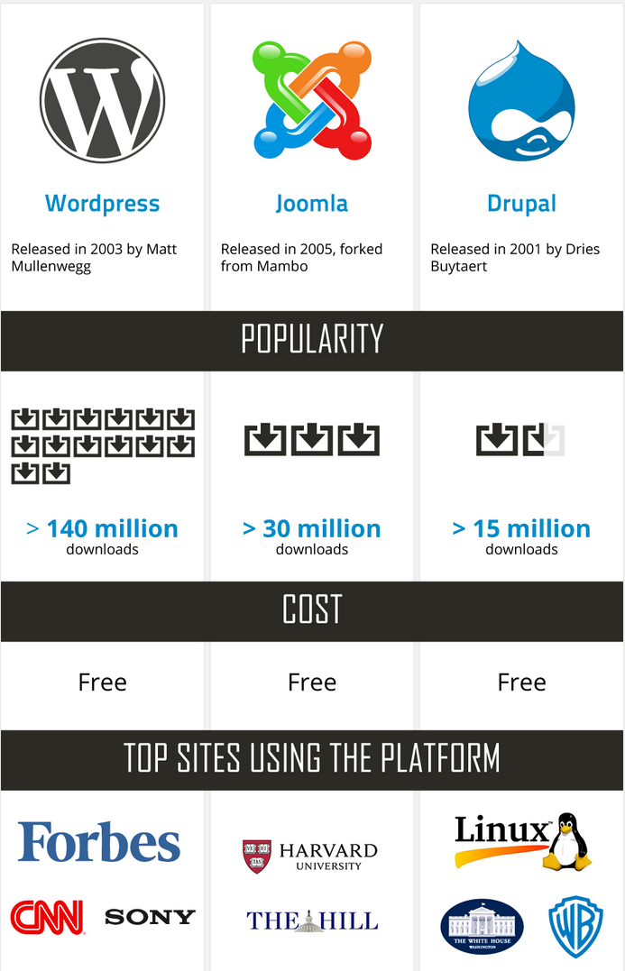
WordPress vs. Others

Slide 7

Demo…

Slide 8
<?php
echo ‘Thank you’;
?>

